Slide 1

US-Mexico Border Crossing Forecast
Group : Josephine M Bagtas
Amisha Sancheti
Aishwary Gawande
Prateek Purwar
Gauri More
Shweta Waknis

Slide 2
INTRODUCTION
To Forecast the data for inbound crossings at the US-Mexico border.
Dataset contains information of the inbound crossings at the U.S.-Canada and the U.S.-Mexico borders
U.S. Customs and Border Protection (CBP) does not count data on outbound crossings

Slide 3
DATA DESCRIPTION

Slide 4
DATA DESCRIPTION
Data Dimension
Rows – 346733
Columns - 8
Column Names
[1] "Port.Name" "State" "Port.Code" "Border" "Date" "Measure" "Value"
Data Period
Monthly Data is taken from January 1996 to March 2019.
[8] "Location"

Slide 5
DATA DESCRIPTION
Borders
US-Mexico Border
US-Canada Border
Measures :
(12 Measures )
Trucks , Rail Containers Full, Trains , Personal Vehicle Passengers, Bus Passengers , Truck Containers Empty ,Rail Containers Empty , Personal Vehicles ,Buses , Truck Containers Full, Pedestrians , Train Passengers, Bus Passengers Buses ... Trucks

Slide 6
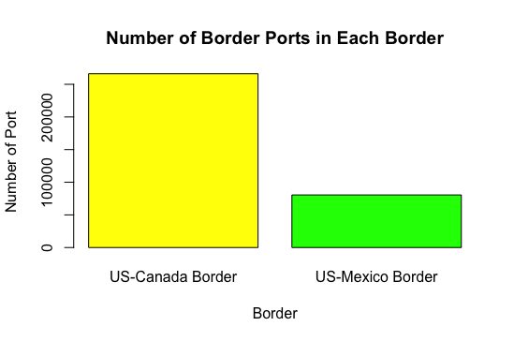
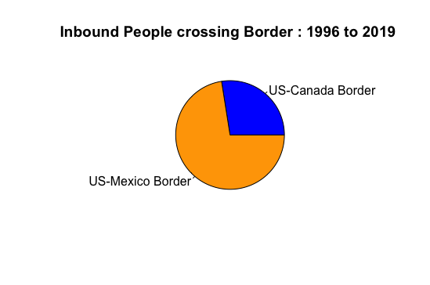
DATA DESCRIPTION
(Border_data = aggregate(data$Value,
by=list(data$Border), FUN=sum))
## Group.1 x ## 1 US-Canada Border 2687962794 ## 2 US-Mexico Border 7085632048

Slide 7
DATA ANALYSIS

Slide 8
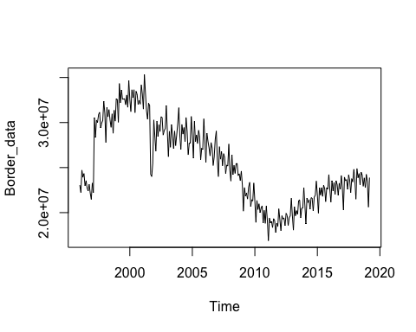
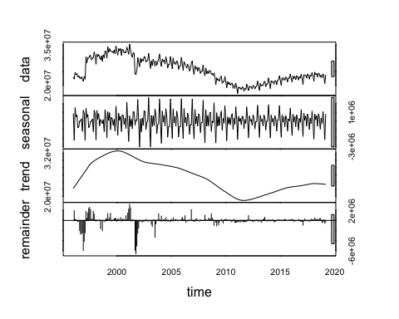
DATA ANALYSIS
Decomposition :
Trend-cycle has captured the sudden fall in the data around 2011-2012

Slide 9
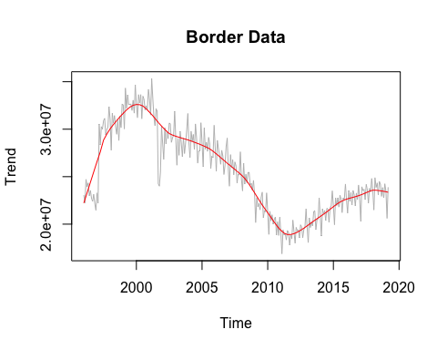
DATA ANALYSIS : Trend on border data
ANALYSIS
North American Free Trade Agreement (NAFTA) came into force in 1994, U.S.-Mexico trade has soared.
2011-2012 down ward trend –
Immigration Law Enforcement
Decline in Fertility
Economic condition in Mexico

Slide 10
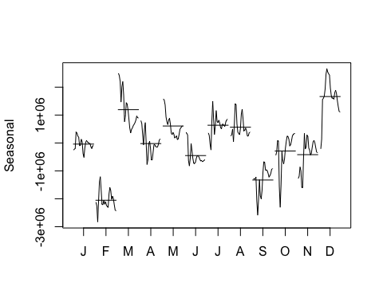
DATA ANALYSIS : Seasonal pattern
ANALYSIS
Seasonal migration have peaked in Spring – March.
In Summer months, migration journey becomes difficult.

Slide 11
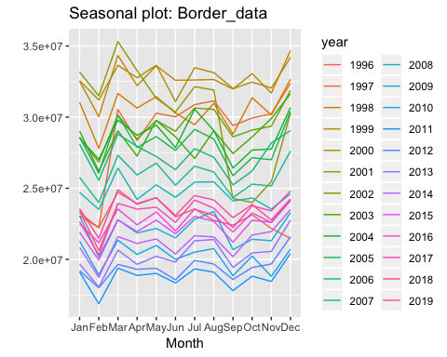
DATA ANALYSIS : Seasonal pattern
ANALYSIS
Considering last 7 years data , March 2018 shows most inbound entry – due to months leading up to the shutdown, there was a large increase in the number of people in family units apprehended at the border.

Slide 12
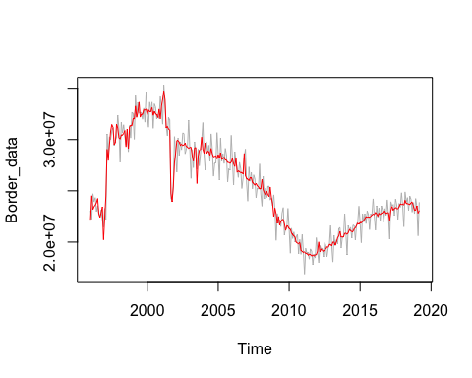
DATA ANALYSIS : Seasonally Adjusted
Red Line shows the seasonally adjusted data

Slide 13
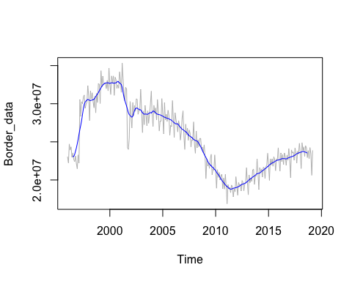
DATA ANALYSIS : MOVING AVERAGE
Blue line shows moving average

Slide 14
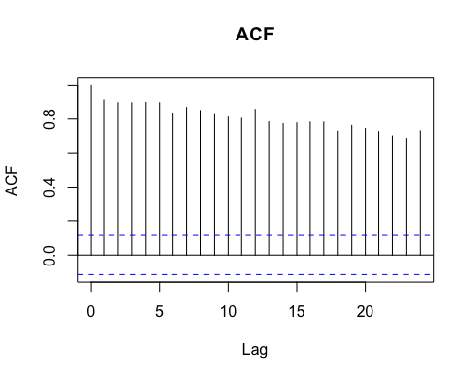
DATA ANALYSIS : AUTOCORRELATION

Slide 15
FORECASTING

Slide 16
Model to Forecast the data

Slide 17
Model to Forecast the data

Slide 18
ARIMA Model to Forecast the data
Kwiatkowski-Phillips-Schmidt-Shin (KPSS) test
Difference
Border data

Slide 19
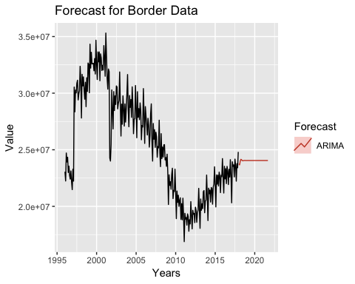
ARIMA Model to Forecast the data
## ARIMA(2,1,2)(1,1,1)[12] : 8090.539
## Best model: ARIMA(2,1,2)(1,1,1)[12]

Slide 20
CONCLUSION

Slide 21
CONCLUSION

Slide 22
CONCLUSION : HOLT WINTER-MULTIPLICATIVE

Slide 23
FUTURE SCOPE
We can categories the inbound values as trade and people (tourist or immigrants)

Slide 24


